Slide 1

Workforce Disability Equality Standard Report (WDES) 2024
Official

Slide 2

The WDES
Background and Context
The Workforce Disability Equality Standard (WDES) was introduced within the NHS in 2019. Its purpose is to ensure that colleagues living with disabilities, long term health conditions, or illnesses have equal access to career opportunities and receive fair treatment in the workplace.
The WDES comprises a set of ten specific measures (metrics) which enables NHS organisations to compare the workplace and career experiences of disabled and non-disabled colleagues. NHS organisations use the metrics data to develop and publish an action plan. Year-on-year comparison enables NHS organisations to demonstrate progress against the indicators of disability equality.
There is a requirement for NHS Trusts to report progress on their performance by publishing their performance and progress against the WDES and submit this information to NHSE on an annual basis. Commissioning Support Units (CSUs) are not required to report on this data by the NHSE WDES team, but it is required by the NHSE Assurance Team. This reporting has been undertaken in line with best practice and for furthering organisational inclusion.

Slide 3

This report provides information on NECS performance against each of the ten WDES indicators for 2023/24. The report also highlights our key achievements, areas for improvement, and an overview of the 2024 action plan.
NECS first produced a WDES report in 2023 and comparisons will be made with the 2022/23 data, with the aim of understanding where improvements are needed against the 10 indicators.
There is currently no requirement for CSUs to report on their WDES data by the WDES Team, but it is required by the NHSE Assurance Team. The 2024 WDES report is being undertaken in line with best practice and to ensure continuous improvement.
The WDES
Background and Context

Slide 4
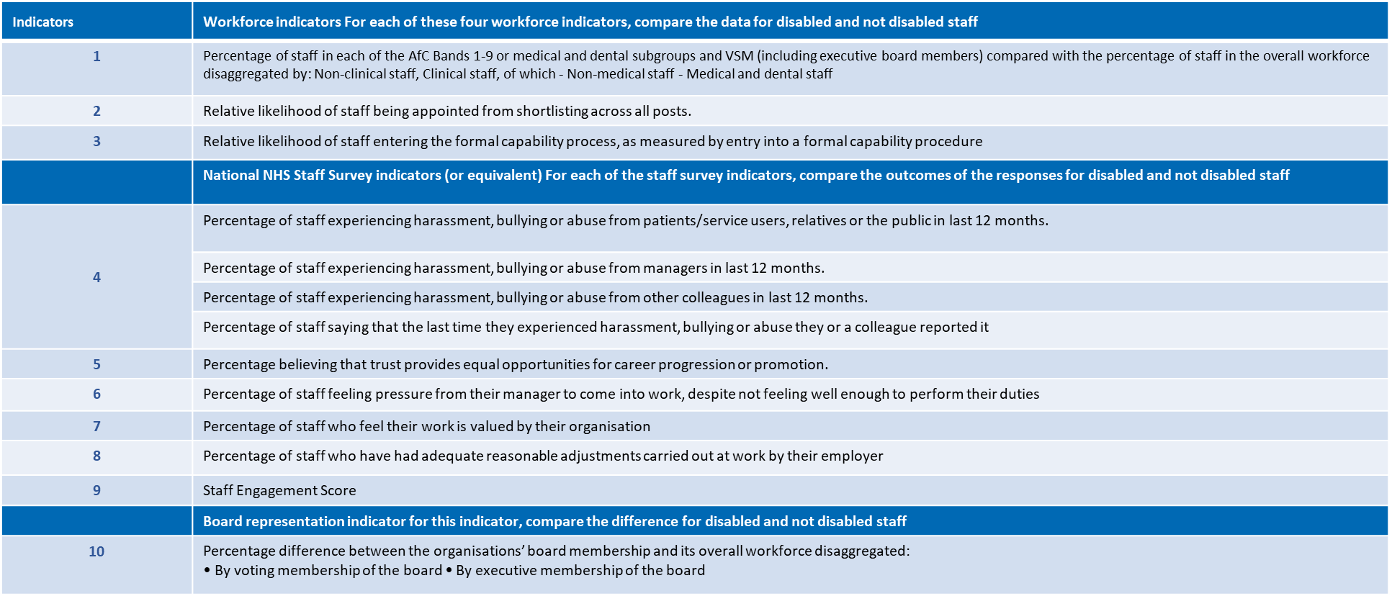
WDES Indicators

Slide 5
NECS Performance Against the WDES Indicators
Official

Slide 6
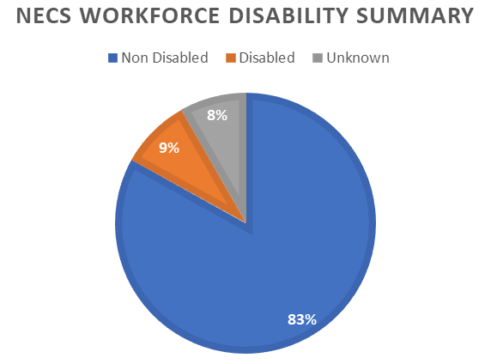
WDES Indicator 1: Overall Breakdown of Workforce Data
Percentage of colleagues in each of the AfC Bands 1-9 or medical and dental subgroups and VSM (including executive board members) compared with the percentage of colleagues in the overall workforce
 | 2022/23 | 2023/24 | 2023/24 Performance compared with 2022/23 (%)
Non-Disabled | 82.4% | 83.0% | +0.6
Disabled | 9.6% | 8.7% | -0.9
Unknown | 8.0% | 8.2% | +0.2%
There has been a 0.9% reduction in the number of disabled colleagues in 2023/24. There has also been a slight increase in the number of colleagues with an unknown disability status of 0.2%. However, during the change process, the number of colleagues in the overall workforce reduced by 5.5% (109 colleagues).

Slide 7
WDES Indicator 1: Overall Breakdown of Workforce Data
Percentage of colleagues in each of the AfC Bands 1-9 or medical and dental subgroups and VSM (including executive board members) compared with the percentage of colleagues in the overall workforce
Disability Status for Each Banding Level
 | 2022/23 |  |  |  | 2023/24
 | Bands 1-4 | Bands 5-7 | Bands 8a-8b | Bands 8c-VSM | Bands 1-4 | Bands 5-7 | Bands 8a-8b | Bands 8c-VSM
Non-Disabled | 80.4 | 80.3 | 90.5 | 81.2 | 82.2 | 81.2 | 89.8 | 80.1
Disabled | 14.3 | 10.3 | 4.1 | 6.7 | 11.2 | 9.0 | 6.2 | 6.6
Unknown | 5.3 | 9.4 | 5.4 | 12.1 | 6.6 | 9.7 | 4.0 | 13.2
There has been a reduction in the number of disabled colleagues in bands 1-4 (-3.1%), 5-7 (-1.3%), and 8c-VSM (-0.1%), but an increase in disabled colleagues in bands 8a-8b (+2.1%), since 2022/23.
Overall, disclosure rates have slightly reduced since 2022/23, with the lowest disclosure rates in bands 5-7 and 8c-VSM.

Slide 8
WDES Indicator 2: Recruitment
Compare the data for Disabled and Non-Disabled colleagues: Relative likelihood of colleagues being appointed from shortlisting across all posts.
2022/23 |  |  |  | 2023/24
 | Shortlisted | Appointed | Relative likelihood of non-disabled applicants being appointed | Shortlisted | Appointed | Relative likelihood of non-disabled applicants being appointed
Disabled | 196 | 28 | 0.82 | 48 | 8 | 1.62
Non-Disabled | 1893 | 221 |  | 388 | 105
Unknown | 66 | 8 |  | 0 | 0
Since 2022/23, a higher proportion of non-disabled applicants have been shortlisted and appointed than disabled applicants.
The relative likelihood of non-disabled applicants being appointed from shortlisting is higher than disabled applicants (1.62), almost doubling since 2022/23 (0.82). This shows that non-disabled applicants more likely to be appointed to a role than disabled applicants.
It should be noted that NECS has been undergoing consultation for much of 2023-24 meaning a 77% reduction in external recruitment compared with previous years, which reduced the opportunity to diversify the workforce through external recruitment.

Slide 9
WDES Indicator 3: Formal Capability Processes
The Relative likelihood of colleagues entering the formal capability process, as measured by entry into a formal capability investigation
NECS records and monitors all capability cases based on protected characteristics and makes note of the reason behind the case. This indicator looks at the number of capability cases over a 2-year period and considers whether they might be on the grounds of ill health
Where the number of colleagues entering a formal capability process is 5 or less, NECS will not disclose or publish the information for reporting purposes to maintain confidentiality and anonymity of individuals subject to such processes
The total number of colleagues that entered a formal capability process across NECS for the period 1st April 2022 to 31st March 2024 is 14 (average of 7 over two years), a reduction from 2021/23, where there were 16 recorded cases over a 2-year period (average of 8 over two years). As certain disability status groups comprise 5 or fewer colleagues entering the formal capability process, it is not possible to share this information
Analysis of the 2022/24 data shows that disabled colleagues are more likely to enter a capability process than their non-disabled counterparts (3.57), an increase from 2021/23 (1.33)
No colleagues have entered a formal capability process on grounds of ill health over the last 2 years

Slide 10
WDES Indicators 4-9: Staff Survey Questions
Percentage of staff that said ‘YES’ to the WDES questions in the 2023 Staff Survey and a comparison with the 2022 results
Staff Survey indicator (WDES) | Disability Status | Survey results
 |  | 2022 | 2023
Indicator 4ai. Percentage of staff experiencing harassment, bullying or abuse from patients/service users, their relatives or the public in the last 12 months | Disabled | 10.9% | 5.3%
 | Non-Disabled | 5.5% | 2.3%
Indicator 4aii. Percentage of staff experiencing harassment, bullying or abuse from managers in the last 12 months | Disabled | 11.9% | 13.5%
 | Non-Disabled | 4.7% | 4.4%
Indicator 4aiii. Percentage of staff experiencing harassment, bullying or abuse from other colleagues in the last 12 months | Disabled | 7.9% | 15.2%
 | Non-Disabled | 3.3% | 6.4%
Indicator 4b- Percentage of staff saying that the last time they experienced harassment, bullying or abuse at work, they or a colleague reported it | Disabled | 41.3% | 61.2%
 | Non-Disabled | 40.7% | 58.9%
Staff Survey indicator (WDES) | Disability Status | Survey results
 |  | 2022 | 2023
Indicator 5. Percentage of staff who believe that their organisation provides equal opportunities for career progression or promotion | Disabled | 58.2% | 59.1%
 | Non-Disabled | 68.0% | 69.2%
Indicator 6. Percentage of staff who have felt pressure from their manager to come to work, despite not feeling well enough to perform their duties | Disabled | 17.2% | 18.2%
 | Non-Disabled | 9.7% | 11.1%
Indicator 7. Percentage of staff satisfied with the extent to which their organisation values their work | Disabled | 47.7% | 47.8%
 | Non-Disabled | 59.3% | 62.3%
Indicator 8- Percentage of staff with a long-lasting health condition or illness saying their employer has made reasonable adjustment(s) to enable them to carry out their work. | Disabled | 81.7% | 82.9%

Slide 11
WDES Indicators 4-9: Staff Survey Questions Continued
Percentage of colleagues that said ‘YES’ to the WDES questions in the 2023 Staff Survey and a comparison with the 2024 results
In 2023/2024, performance against the staff survey indicators has been largely positive, with improvements in experience for both disabled and non-disabled colleagues for indicators 4ai, 4b, 5, 7 and 8.
There has been an increase in the number of disabled and non-disabled colleagues experiencing harassment, bullying and abuse from colleagues in the last 12 months (indicator 4aiii); and presenteeism, where colleagues have felt pressure from their manager to come to work, despite not feeling well enough to perform their duties (indicator 6).
There has been an increase in the number of disabled colleagues reporting that they have experienced harassment, bullying and abuse managers in the last 12months (indicator 4aii) and a nominal reduction in staff engagement (indicator 9a).
Overall, while colleague experience has improved, disabled colleagues have a worse experience than non-disabled colleagues for all indicators, except indicator 4b where reporting is higher for disabled staff.
Staff Survey indicator (WDES) | Disability Status | Survey results
 |  | 2022 | 2023
Indicator 9a. Staff engagement score (0-10) | Disabled | 6.6 | 6.5
 | Non-Disabled | 7.0 | 7.0
Indicator 9b. Has your organisation taken action to facilitate the voices of your disabled staff to be heard? (yes) or (no) | - |  | Yes

Slide 12
WDES Indicator 10: Board Member Representation
Percentage difference between the organisations’ Board (Exec) membership and its overall workforce
Board Membership
 | 2022/23 |  |  |  | 2023/24
 | Disabled | Non Disabled | Unknown | Total | Disabled | Non Disabled | Unknown | Total
Count | 1 | 5 | 2 | 8 | 1 | 3 | 2 | 6
Percentage | 12.5% | 62.5% | 25.0% |  | 16.7% | 50% | 33.3%
No. of Colleagues in Workforce |  | Board Membership |  |  |  | Board Membership
 | 2022/23 |  |  |  | 2023/24
 | Disabled | Non Disabled | Unknown | Total | Disabled | Non Disabled | Unknown | Total
Count | 189 | 1630 | 159 | 1978 | 163 | 1552 | 154 | 1869
Percentage | 9.6% | 82.4% | 8.0% |  | 8.7% | 83.0% | 8.2%
The data indicates that the number of disabled colleagues on the Board (within NECS, the Executive team) is largely representative of the disability demographics in the workforce. However, there is a higher percentage of Members who have not shared their disability status, than there is in the wider workforce.

Slide 13
Summary and Next Steps
Official

Slide 14
What we have done well
There has been a slight reduction (-0.9%) in the number of disabled colleagues in the workforce, with 8.7% of the workforce report having a disability or long-term illness. This is lower than the current population of disabled people in England and Wales, which is estimated at 17.8% (2021 Census)
There has been an increase (+2.1%) in the number of disabled colleagues within bands 8a-8b
The total number of colleagues that entered a formal capability process across NECS for the period 1st April 2022 to 31st March 2024 has reduced by 2 since 2021/23. In addition, no colleagues have entered the formal capability process on the grounds of ill-health over the last 2 years
There has been a reduction in the percentage of disabled colleagues experiencing harassment, bullying and abuse from patients/service users, relatives, members of the public (-5.6%) over the last 12 months. There has also been an increase in the number of disabled colleagues who are willing to report harassment, bullying and abuse (+19.9%); believing the organisation offers equal opportunities (+0.9%); feeling their work is valued by the organisation (+0.1%); and receiving reasonable adjustments in the workplace (+1.2%)

Slide 15
What we have done well
In terms of the Executive Team, the percentage of disabled members (16.7%) in the executive team is greater than the percentage of disabled colleagues in the workforce (8.7%)
NECS successfully delivered their first Inclusion and Equality Strategy in 2023. The strategy utilised workforce data including the 2023 WRES Report to deliver meaningful change. This involved the launch of a Zero Tolerance to Bullying and Harassment campaign, the development of the Inclusion Network, the relaunch of Safe Space events, recruitment improvements, and development and delivery of Equality, Diversity and Inclusion (EDI) Training. A full summary of the 2023 Inclusion and Equality Strategy can be found here. The new EDI Strategy plan on a page, developed to support this 2024 WDES report is included on slide 18

Slide 16
Where we need to improve
While the greatest number of disabled colleagues fall within bands 1-4 and bands 5-7, there has been an increase in the number of disabled colleagues within bands 8a-8b and the number of disabled colleagues within bands 8c-VSM (-0.1%) is only nominally lower than 2022/23
A good range for the relative likelihood of an applicant’s appointment from shortlisting is between 0.85 and 1.5. The relative likelihood in NECS is 1.62, indicating that disabled applicants are slightly less likely to be appointed from shortlisting than non-disabled applicants. The ideal aim is to achieve a relative likelihood of 1, where disabled and non-disabled applicants have an equal likelihood of appointment
Analysis of the 2022/24 formal capability data shows that disabled colleagues are more likely (3.57 relative likelihood) to enter a capability process than their non-disabled counterparts, an increase from 1.33 in 2022/23. However, the average number of colleagues entering a formal capability process is extremely low, with there being an average of 7 colleagues in total in 2022/24 and 8 colleagues in total in 2021/23.

Slide 17
Where we need to improve
There has been an increase in reporting for disabled and non-disabled colleagues for indicators 4aiii and 6 relating to experiencing harassment, bullying and abuse from colleagues in the last 12 months (+7.3%); and presenteeism, where colleagues have felt pressure from their manager to come to work, despite not feeling well enough to perform their duties (+1.0%)
There has also been an increase, for indicator 4aii, in the number of disabled colleagues experiencing harassment, bullying and abuse from managers in the last 12months (+1.6%); and a nominal reduction, for indicator 9a, in staff engagement (-0.1). Overall, while colleague experience has improved, there has been an increase in reporting from disabled colleagues for all indicators
In terms of disclosure rates, 8.2% of the workforce have chosen not to share their disability status. Additionally, 33.3% of Board Members (2 people) have chosen not to share their disability status. Therefore, fewer Board Members are disclosing their disability status than colleagues in the workforce. Additionally, when compared with anonymised disclosure rates, 25.6% of colleagues who completed the staff survey identified as being disabled. While just under 75% of NECS colleagues completed the staff survey, we need to increase disability status sharing rates on ESR. A reluctance to share demographic data could be an indication of colleague trust levels for an organisation and psychological safety

Slide 18
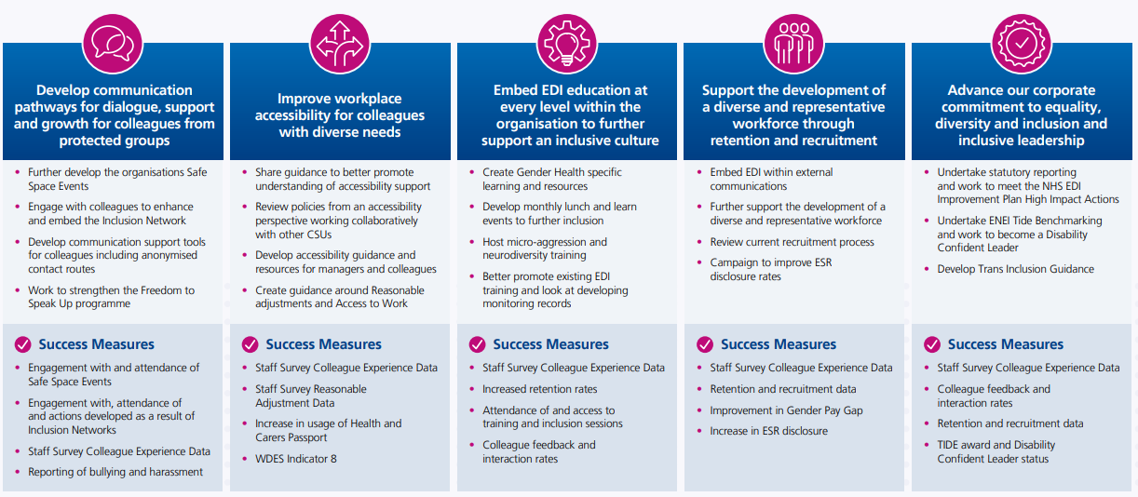
Equality, Diversity and Inclusion Strategy 2024

