Slide 1

Workforce Race Equality Standard Report (WRES) 2024
Official

Slide 2

Following the Snowy White Peaks Report by Professor Roger Kline in 2014, the NHS Equality and Diversity Council announced on 31 July 2014 that it had agreed action to ensure employees from black and minority ethnic (BME) backgrounds had equal access to career opportunities and received fair treatment in the workplace.
Further to this, the NHS introduced the Workforce Race Equality Standards (WRES) in April 2015 to review and close gaps in workplace inequalities between Black, Asian and Minority Ethnic (BAME) staff members and White staff members.
All NHS organisations were encouraged, and Trusts were mandated, to implement the WRES in an open and transparent way to demonstrate how they were addressing race equality issues.
While undertaking the WRES is not a requirement for Commissioning Support Units from the NHSE WRES Team, it is something that is required by the NHSE Assurance Team and it is completed in line with best practice, and for furthering organisational inclusion.
The WRES
Background and Context

Slide 3

NHS providers are expected to show progress against several indicators of workforce equality, including a specific indicator to address the low numbers of board members from Ethnically Diverse Groups across the organisation.
NECS has produced a WRES report since 2016 with the aim of making improvements against the 9 indicators.
The WRES will continue to work to evidence the outcomes of the work that is done, publishing data intelligence and supporting the system by sharing replicable good practice.
The WRES data is usually reported by the 31st May and an action plan is required by 31st October. However, there is currently no requirement for CSUs to report on their WRES data from the NHSE WRES Team. The 2024 WRES is being undertaken to meet NHSE Assurance Team requirements and in line with best practice, to ensure continuous improvement.
The WRES
Background and Context

Slide 4
WRES Indicators
Indicator | Workforce Indicators – For each of these 4 workforce indicators, data from white and BME colleagues are compared
1 | Percentage of staff in each of the AfC bands 1-9 and VSM (including exec. Board members) compared with the percentage in the overall workforce. Note – Organisations should undertake this calculation separately for clinical and non-clinical staff
2 | Relative likelihood of staff being appointed from shortlisting across all posts
3 | Relative likelihood of staff entering formal disciplinary process, as measured by entry into a formal disciplinary investigation
4 | Relative likelihood of staff accessing non-mandatory training and CPD
 | National NHS Staff Survey Indicators – For each of the 4 staff survey indicators, the outcomes of the responses are compared for white and BME colleagues
5 | KF.25 Percentage of staff experiencing harassment, bullying or abuse from patients, relatives or the public in the last 12 months
6 | KF.26 Percentage of staff experiencing harassment, bullying or abuse from staff in the last 12 months
7 | KF.21 Percentage believing that the trust (organisation) provides equal opportunities for career progression or promotion
8 | Q.217 In the last 12 months, have you personally experienced discrimination at work from any of the following? Manager/team leader or other colleagues
 | Board Representation Indicator - For this indicator, the difference for white and BME staff is compared
9 | Percentage difference between the organisation’s Board voting membership and its overall workforce. Note – Only voting members of the Board should be included when considering this indicator

Slide 5
NECS Performance Against the
WRES Indicators
Official

Slide 6
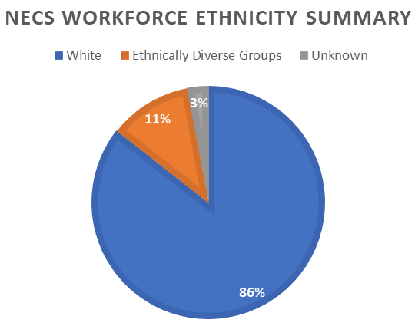
WRES Indicator 1: Overall Breakdown of Workforce Data
Percentage of colleagues in each of the AfC Bands 1-9 or medical and dental subgroups and VSM (including executive board members) compared with the percentage of colleagues in the overall workforce
 | 2020/21 | 2021/22 | 2022/23 | 2023/24 | 2023/24 Performance compared with 2022/23 (%)
White | 86.4% | 87.4% | 85.6% | 85.6% | -
Ethnically Diverse Groups | 7.6% | 10.3% | 11.5% | 11.5% | -
Unknown | 6.0% | 2.3% | 2.8% | 2.9% | +0.1%
The percentage of colleagues from ethnically diverse groups is 11.5% which is lower than the population in England and Wales (18.3%, 2021 Census).

Slide 7
WRES Indicator 1: Overall Breakdown of Workforce Data
Percentage of colleagues in each of the AfC Bands 1-9 or medical and dental subgroups and VSM (including executive board members) compared with the percentage of colleagues in the overall workforce
Ethnicity Split for Each Banding Level
 | 2022/23 |  |  |  | 2023/24
 | Bands 1-4 | Bands 5-7 | Bands 8a-8b | Bands 8c-VSM | Bands 1-4 | Bands 5-7 | Bands 8a-8b | Bands 8c-VSM
White | 83.6% | 86.0% | 83.5% | 92.7% | 82.7% | 86.3% | 84.1% | 92.7%
Ethnically Diverse Groups | 12.4% | 11.7% | 13.1% | 4.8% | 13.7% | 10.8% | 13.7% | 4.6%
Unknown | 4.0% | 2.3% | 3.3% | 2.4% | 3.6% | 2.9% | 2.2% | 2.7%
There has been no change in the percentage of colleagues from ethnically diverse groups between 2022/23 and 2023/24.
There has also been a slight increase in the number of colleagues from an unknown ethnicity since 2021/22, which indicates a nominal reduction in ESR completion rates.
There has been a reduction in the number of colleagues from ethnically diverse groups for bands 5-7 and 8c-VSM, but an increase in ethnically diverse colleagues in bands 1- 4 and bands 8a-8b, since 2022/23.

Slide 8
WRES Indicator 2: Recruitment
Ethnicity comparison for: Relative likelihood of colleagues being appointed from shortlisting across all posts
2022/23 |  |  |  | 2023/24
 | Shortlisted | Appointed | Relative likelihood of white applicants being appointed | Shortlisted | Appointed | Relative likelihood of white applicants being appointed
Ethnically Diverse Groups | 697 | 63 | 1.46 | 143 | 18 | 2.67
White | 1414 | 187 |  | 279 | 94
Unknown | 42 | 7 |  | 14 | 1
Since 2023/24, white applicants are now 2.67 times more likely to be appointed than applicants from ethnically diverse groups, this is an increase from 2022/23 (1.46 likelihood).
This change indicates more work still needs to be done to ensure that the likelihood of appointment is equal for all applicants regardless of ethnicity.
It should be noted that NECS has been undergoing consultation for much of 2023/24 and there was a 77% reduction in recruitment compared with previous years, which reduced the opportunity to diversify the workforce through external recruitment.

Slide 9
WRES Indicator 3: Colleagues Entering Formal Disciplinary Processes
The Relative likelihood of ethnically diverse colleagues entering the formal disciplinary process compared with white colleagues, as measured by entry into a formal disciplinary investigation
NECS records and monitors all disciplinary cases against the protected characteristics
Where the number of colleagues entering a formal disciplinary process is 5 or less, NECS will not disclose or publish the information for reporting purposes to maintain confidentiality and anonymity of individuals subject to such processes
For the period 1st April 2023 to 31st March 2024, 20 colleagues entered a formal disciplinary process across NECS. This has increased by 10 since 2022/23
As there are 5 or fewer colleagues who have entered the formal disciplinary process in certain ethnic groups, it is not possible to disclose detailed information. Analysis of the data shows that colleagues from ethnically diverse groups are slightly less likely than white colleagues to enter a disciplinary process, with a likelihood of 0.99. This has improved since 2022/23, where ethnically diverse colleagues had a 1.24 times more likely to enter a disciplinary process than their white counterparts. This is the second consecutive year in a row in which we have seen an improvement.

Slide 10
WRES Indicator 4: Non-mandatory training and continuous professional development
Ethnicity comparison for: Relative likelihood of colleagues accessing non-mandatory training and continuous professional development (CPD)
 | 2022/23 | 2021/22 | 2023/24
 | % colleagues accessing non-mandatory training and CPD | Relative likelihood of white colleagues accessing non-mandatory training and CPD compared to colleagues from Ethnically Diverse Groups | % colleagues accessing non-mandatory training and CPD | Relative likelihood of white colleagues accessing non-mandatory training and CPD compared to colleagues from Ethnically Diverse Groups
Ethnically Diverse Groups | 126 | 1.13 | 160 | 1.01
White | 1060 |  | 1210
Unknown | 22 |  | 165
There has been a rise in undisclosed ethnicity statuses from those accessing training. 1.8% of colleagues chose not to disclose their ethnicity in 2022/23 and this rose to 10.7% of colleagues in 2023/24.
A likelihood of 1.00 would indicate that there is an equal likelihood of ethnically diverse and white colleagues accessing training. However, a good range is considered to be between 0.85 and 1.5 in terms of likelihood.
In 2023/24, the likelihood of ethnically diverse colleagues accessing non-mandatory training and CPD is almost equally likely (1.01) to white colleagues. This is an improvement from 2022/23, white colleagues were slightly more likely (1.13) to access non-mandatory training and CPD than colleagues from ethnically diverse groups.

Slide 11
WRES Indicators 5-8: Staff Survey Questions
Percentage of colleagues that said ‘YES’ to the WRES questions in the 2023 Staff Survey and a comparison with the 2022 results
Staff Survey indicator (WRES) | Ethnic Group | Survey results
 |  | 2022 | 2023
Indicator 5- KF 25. Percentage of colleagues experiencing harassment, bullying or abuse from patients, relatives or the public in last 12 months | White | 4.7% | 3.1%
 | Ethnically Diverse Groups | 0.9% | 2.9%
Indicator 6- KF 26. Percentage of colleagues experiencing harassment, bullying or abuse from colleagues in last 12 months | White | 11.1% | 12.1%
 | Ethnically Diverse Groups | 8.2% | 13.1%
Indicator 7- KF 21. Percentage believing that trust provides equal opportunities for career progression or promotion | White | 67.5% | 68.1%
 | Ethnically Diverse Groups | 51.4% | 54.7%
Indicator 8- Q17- In the last 12 months have you personally experienced discrimination at work from Manager/team leader or other Colleagues? | White | 4.8% | 4.4%
 | Ethnically Diverse Groups | 10.0% | 10.8%
In 2023/2024, performance against the staff survey indicators has been positive with improvements in experience for both white and ethnically diverse colleagues for indicators 7 and for white colleagues for indicators 5 and 8.
There has been an increase in the percentage of both white and ethnically diverse colleagues experiencing harassment, bullying and abuse for from colleagues, indicator 6. There has also been increases in the number of ethnically diverse colleagues experiencing harassment, bullying or abuse from patients, relatives or the public (indicator 5) and relating to experiencing discrimination at work from manager/team leader or other colleagues (indicator 8).
Overall, more colleagues from ethnically diverse groups higher incidences of reporting than their white counterparts for indicators 5 to 8. However, it should be noted that only 65% of colleagues from ethnically diverse groups completed the staff survey, compared with 76% white colleagues.
These results could be an indicator of the change across the NHS.

Slide 12
WRES Indicator 9: Board Membership Representation
Percentage difference between the organisations’ Board (Exec Team) membership and its overall workforce
Board Membership
 | 2022/23 |  |  |  | 2023/24
 | White | Ethnically Diverse Groups | Unknown | Total | White | Ethnically Diverse Groups | Unknown | Total
Count | 7 | 1 | 0 | 8 | 5 | 1 | 0 | 6
Percentage | 87.5% | 12.5% | 0.0% |  | 83.3% | 16.7% | 0.0%
No. of Colleagues in Workforce |  | Board Membership |  |  |  | Board Membership
 | 2022/23 |  |  |  | 2023/24
 | White | Ethnically Diverse Groups | Unknown | Total | White | Ethnically Diverse Groups | Unknown | Total
Count | 1694 | 228 | 56 | 1978 | 1600 | 215 | 54 | 1869
Percentage | 85.6% | 11.5% | 2.8% |  | 85.6% | 11.5% | 2.9%
The data indicates that the ethnically diverse members on Board (Exec Team) is largely representative of the ethnicity demographics in the workforce. In terms of disclosure, all members have shared their ethnicity data.

Slide 13
Summary and Next Steps
Official

Slide 14
What we have done well
In 2023/24 our people comprised 11.5% ethnically diverse colleagues, this is the same proportion of ethnically diverse colleagues as 2022/23. There has also been an increase in the number of ethnically diverse colleagues for bands 1-4 (+0.6%) and 8a-8b (+0.3%) in 2023/24
In 2023/24, ethnically diverse colleagues are slightly less likely to enter a formal disciplinary process than white colleagues, with a likelihood of 0.99, this is an improvement from 2022/23 (1.24)
Ethnically diverse colleagues are now almost equally likely (1.01) to access non-mandatory training as white colleagues, this is an improvement from 2022/23 (1.13)
There has been an increase (+3.3%) in the percentage of white and ethnically diverse colleagues believing the organisation provides equal opportunities for career progression and promotion
In terms of the Executive team, the ethnic diversity of members are largely representative of the workforce

Slide 15
What we have done well
NECS successfully delivered their first Inclusion and Equality Strategy in 2023. The strategy utilised workforce data including the 2023 WRES Report to deliver meaningful change. This involved the launch of a Zero Tolerance to Bullying and Harassment campaign, the development of the Inclusion Network, the relaunch of Safe Space events, recruitment improvements, and development and delivery of Equality, Diversity and Inclusion (EDI) Training.
A full summary of the 2023 Inclusion and Equality Strategy can be found here. The new EDI Strategy plan on a page, developed to support this 2024 WRES report is included on slide 17

Slide 16
Where we need to improve
The percentage of colleagues from ethnically diverse groups (11.5%) is lower than the population in England and Wales (18.3%, 2021 Census)
In terms of banding, there has been a reduction in the number of colleagues from ethnically diverse groups for bands 5-7 (-0.9%) and 8c-VSM (-0.2%). It should be noted that there has also been an increase in the number of colleagues from an unknown ethnicity for bands 5-7 (+0.6%) and 8c-VSM (+0.3%)
In 2023/24 there has been a decrease in the number of ethnically diverse applicants appointed and an increase in the likelihood of appointment of white applicants when compared to applicants from ethnically diverse groups (2.67), compared with 2022/23 (1.46). However, it should be noted that NECS has been undergoing consultation for much of 2023/24 and as such there has been a 77% reduction in external recruitment, compared with previous years
There has been an 8.9% increase in the number of colleagues accessing non-mandatory training and choosing not to share their ethnicity status. Rates of ethnicity data sharing within the organisation need to be improved

Slide 17
Where we need to improve
Since 2022/23, there has been an increase in both white (+1.0%) and ethnically diverse (+4.9%) colleagues experiencing harassment, bullying or abuse from colleagues. For ethnically diverse colleagues there has also been an increase in harassment, bullying or abuse from patients, relatives or the public (+2.0%); and in discrimination at work from a manager/team leader or other colleagues (+0.8%)
Overall, there has been an increase in ratings form colleagues from ethnically diverse groups. However, it should be noted that only 65% of colleagues from ethnically diverse groups completed the staff survey, compared with 76% white colleagues
ESR disclosure rates need to be improved across the organisation. Colleague reluctance to share demographic information often relates to their level of trust in an organisation, and their psychological safety

Slide 18
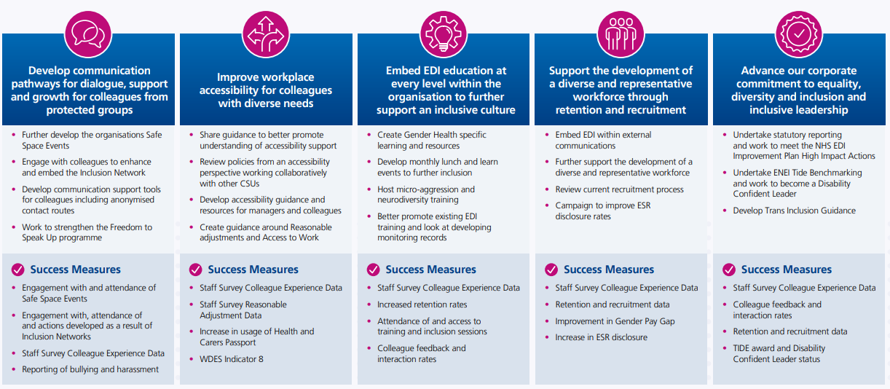
Equality, Diversity and Inclusion Strategy 2024

